Slide 1

Stage 3 Black Tie Event Course Designer: Eric Beerbaum
Black Tie Event is a 28 round, 140 point Comstock long course. There are 14 USPSA targets. The best two hits per target will score. The start signal is audible.
The Handgun start position is handgun loaded and holstered, heels on Xs, wrists below belt. The PCC start position is PCC loaded, heels on Xs, stock touching belt, muzzle pointed downrange.
On the audible start signal, engage all targets from within the shooting area.

Slide 2
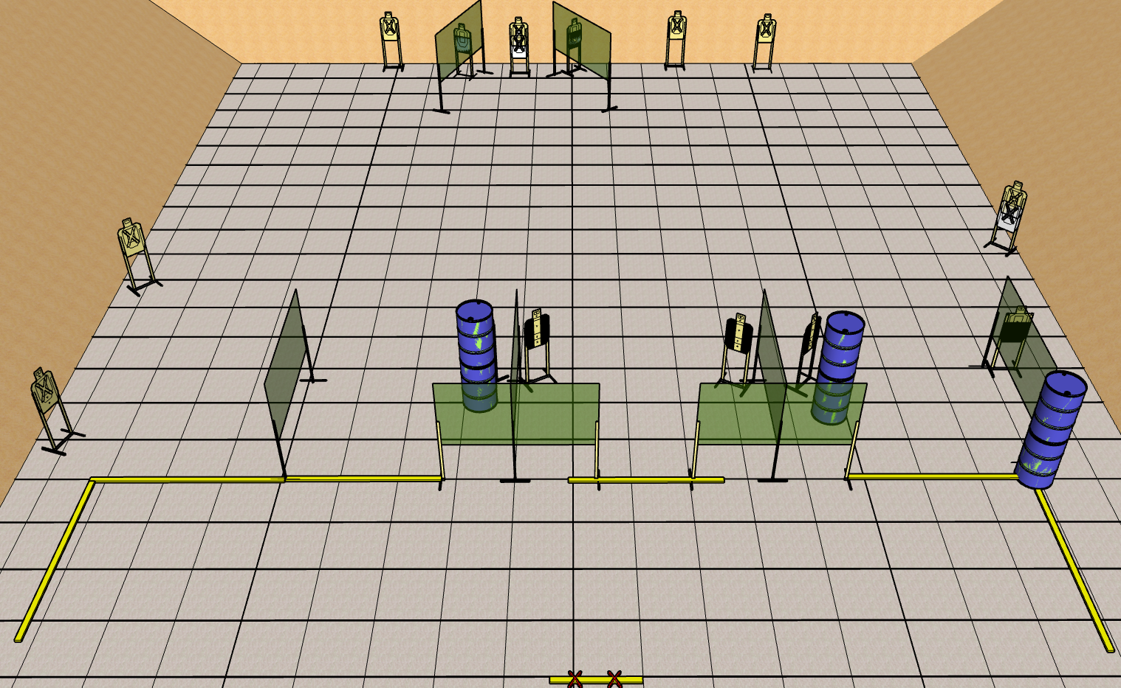
 | Renton Fish and Game Bay 3 Black Tie Event Course Designer: Eric Beerbaum

